Slide 1
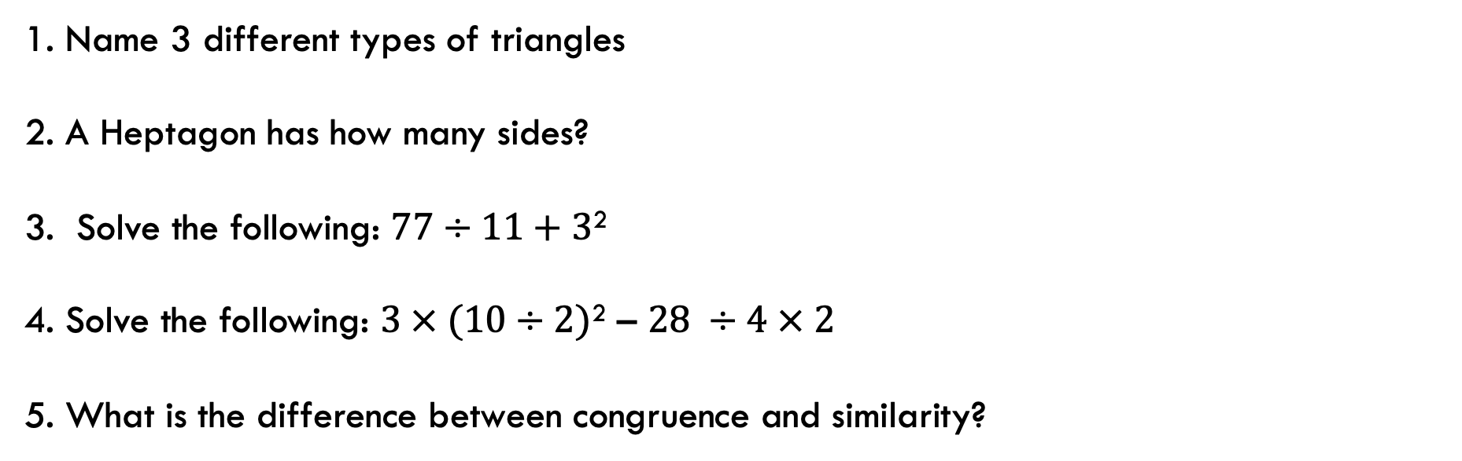
Starter – Daily 5
1. Name 3 different types of triangles
2. A Heptagon has how many sides?
3. Solve the following: $77÷11+3$²
4. Solve the following: $3 × (10÷2)$² – $28 ÷4 × 2$
5. What is the difference between congruence and similarity?

Slide 2
Geometric Properties
EQ – Describe the properties of angles in parallel lines?

Slide 3
Learning Objectives
Review angle properties
Solve problems involving angle properties

Slide 4
Geometric Properties EQ – Describe the properties of angles in parallel lines
Task:
Can you find the missing angles. Give a reason for your answer.

Slide 5
Geometric Properties EQ – Describe the properties of angles in parallel lines

Slide 6
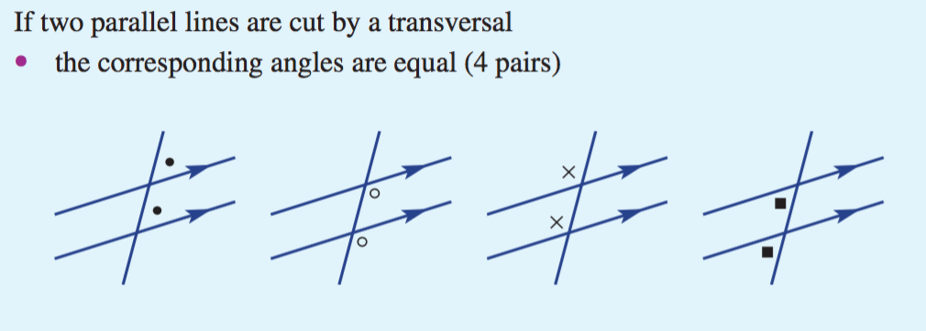
Geometric Properties EQ – Describe the properties of angles in parallel lines
How can find missing angles in parallel lines?
Parallel lines are two lines that do not cross.
The two lines are always equidistance from each other.
When the lines are intersected by a transversal line, the angle formed by this line is the same on both parallel lines.
Example:

Slide 7
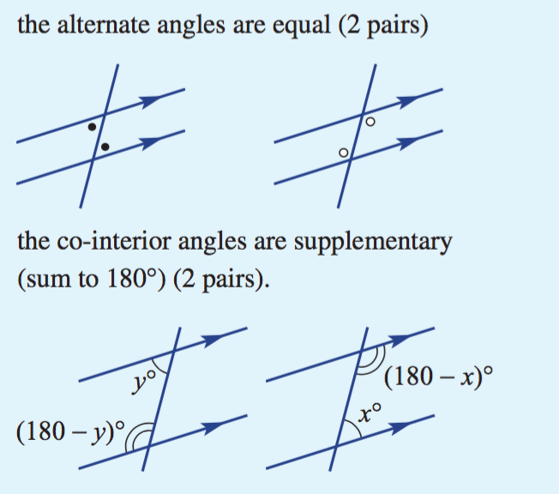
Geometric Properties EQ – Describe the properties of angles in parallel lines
There are 4 relationships we deal with in parallel lines –
Corresponding : same position
Vertically Opposite: Two angles opposite each other
Co-interior: Two angles that at supplementary (add to 180º)
Alternate: Two angles in the same position around a point.

Slide 8
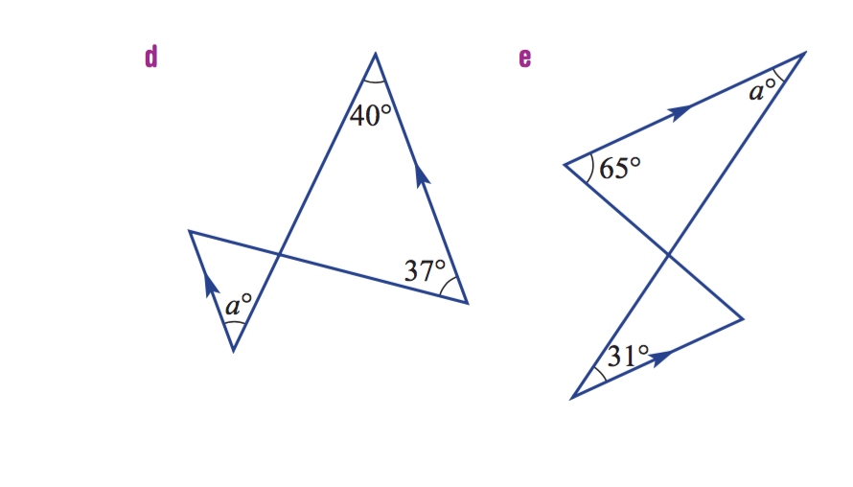



Geometric Properties EQ – Describe the properties of angles in parallel lines
Parallel lines can also be used in congruency statements as proof of angle sizes; e.g.
$∠a is alternate to {40}^{o},$
$∠b is alternate to {37}^{o}$
$∠c is supplementary to {180}^{o}, and vertically opposite$
Because both transversals cross the parallel set of lines, all angles in alternate positions are equal. As such, both triangles are congruent with an (AAA) relationship.
$$b^{o}$$
$$c^{o}$$

Slide 9
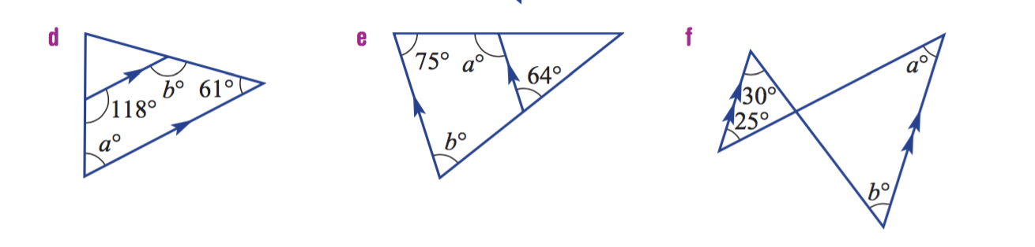
Geometric Properties EQ – Describe the properties of angles in parallel lines
Practise:
A
D
A
C
A
D
E
C
C
D
E
B
B
B
E

